Slide 1
Week 19

Slide 2
Project Status
Function | Issue | Status
Paperless | Apply and move data for F12
 | Lock & UnLock line for C02
 | Abnormal: Filter data by shift
 | Webserivce download BOM Agile
 | Webservice get list PN online by wo and station (Allpart)
 | Update HTTPS for Paperless System
ECN | Support user F12
 | Update struct user and form in ECN Evaluation
 | Update notify warning
 | Update struct ECN evaluation for F12 + B05
 | ECN cut in B04, B06, B05
FAI | SMT: Program machine collection data (auto update program)
 | SMT: Update service for program collection data
 | FAI information page (MO, PNs information) => Mobile view
 | SMT Dashboard (B04)
 | FAI detail for SMT
 | Update process and permission check FAI for User (PD + ME -> Check / QA -> Confirm)
 | Upgrade permission user in system
 | API push data form DCC Control (DCC verify)

Slide 3
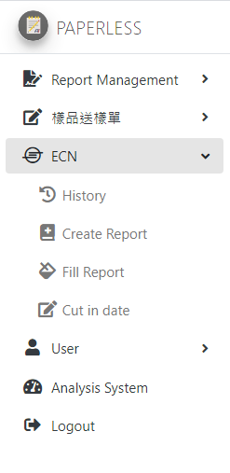
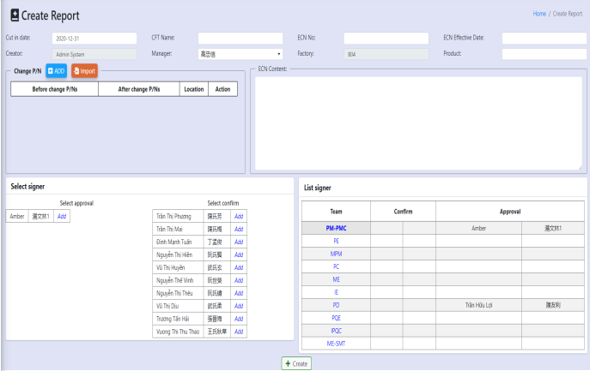
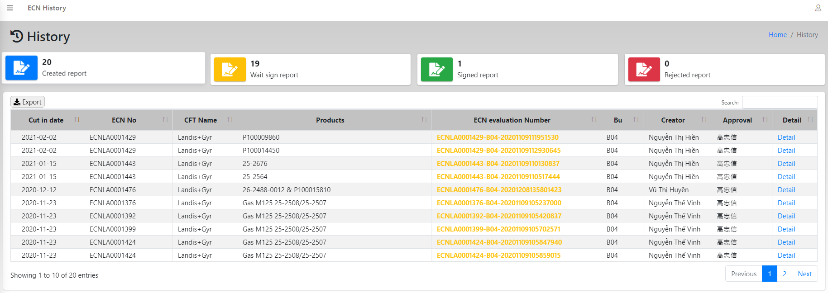
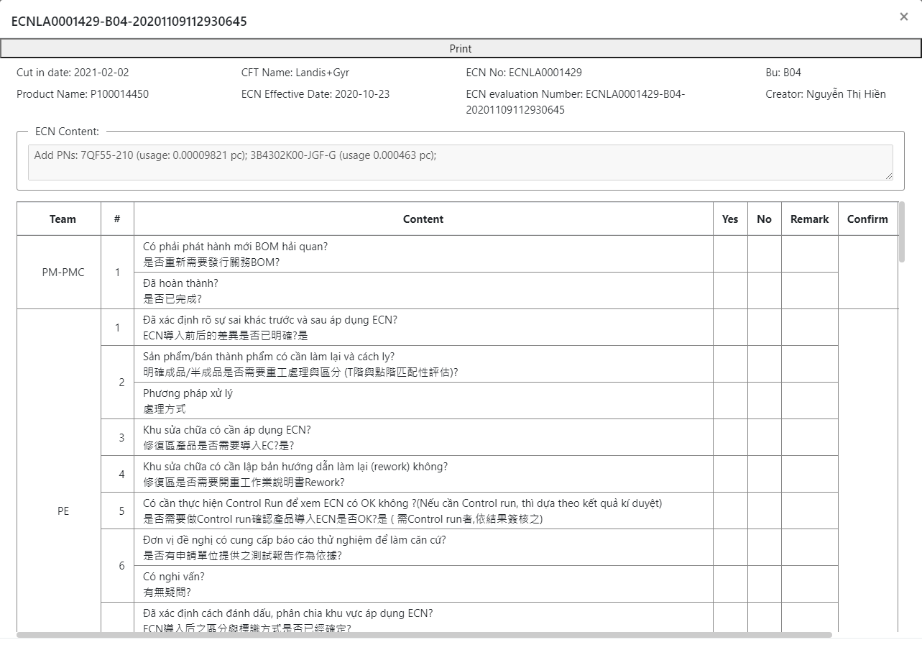
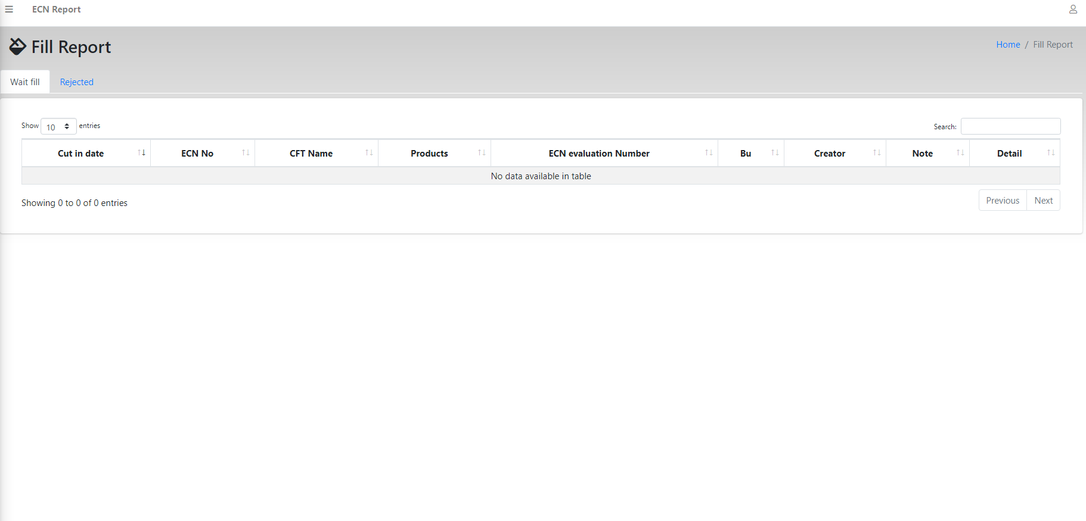
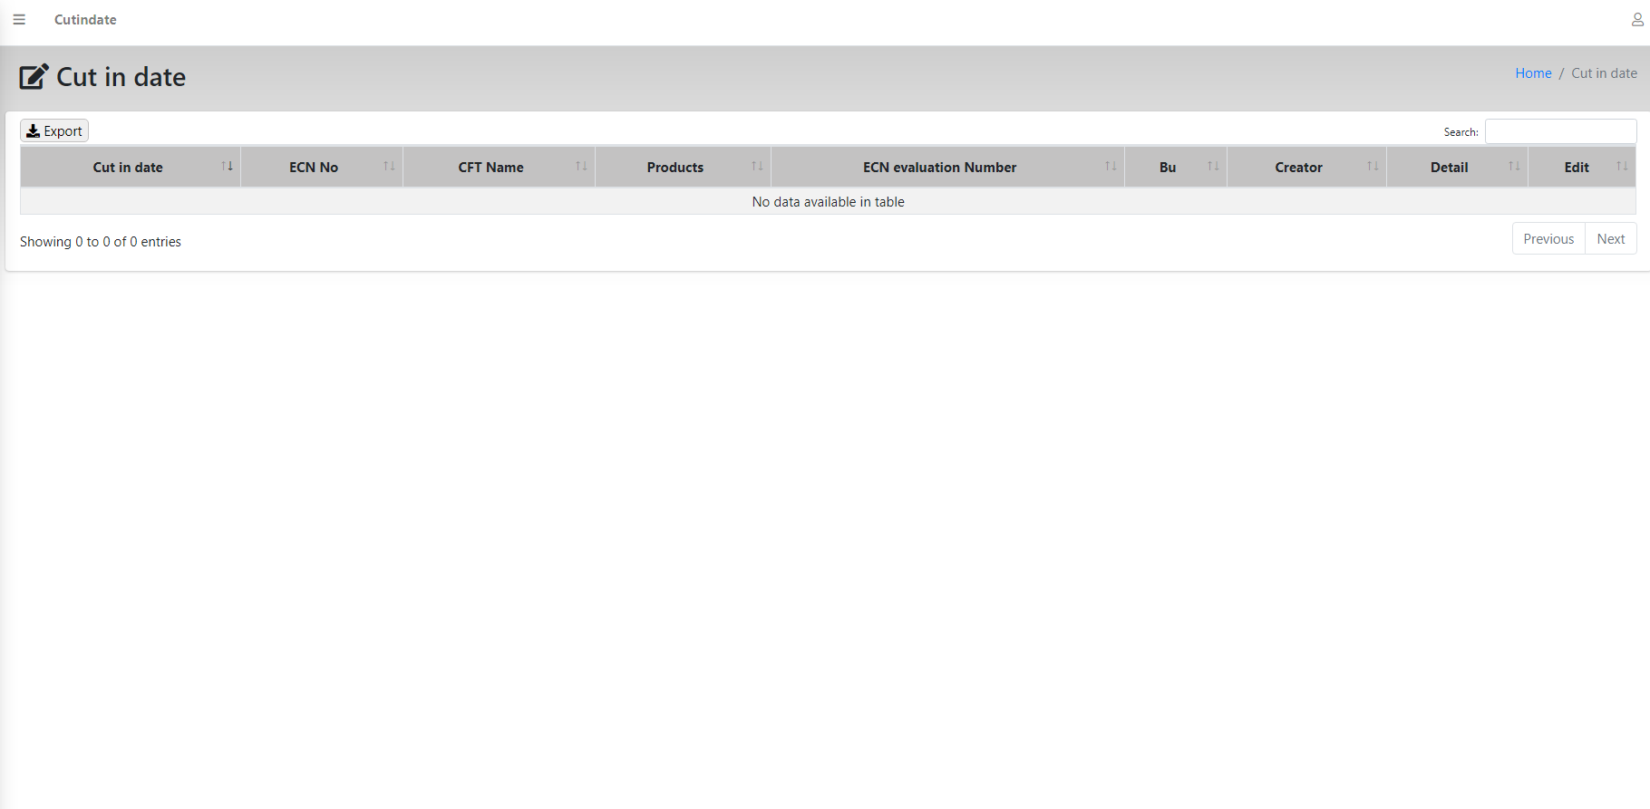
ECN Evaluation Page
http://10.224.81.94:8888/paperless
已完成
已完成
已完成
Update change PN
1, Create ECN Evaluation Page
(When ECN new then PM will login the system
and create ECN, fill information and content to report)
2, History & Sign Page
(Checker will checking ECN report and checking report status in system)
3, ECN Evaluation Detail Page
(Curator check information and content ECN report)
已完成
已完成
4, Fill ECN Evaluation Fill Content Page
(Other team “PM, PE, MPM, PC,…” will check ECN report and fill content for report)
5, Update Cut-in Date Time
(Extend more cut in date for ECN)

Slide 4



ECN Evaluation Page
http://10.224.81.94:8888/paperless
Remind for Owner (Done)
(When the date comes cut in date the system will have send notify for them)
ECN
Connecting with other system (Ongoing)
(Checking PNs status when IQC confirm PN is already)
FII
IT
Check Information ECN (Open)
(When checker checking FAI checklist, they will open ECN report and read content)

Slide 5
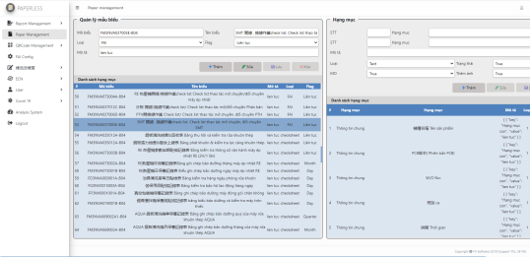
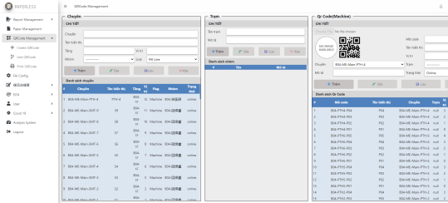
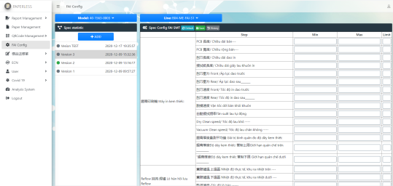
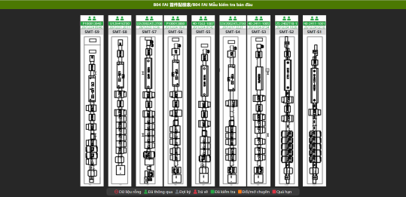
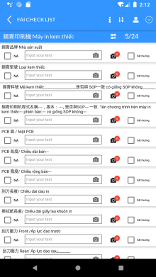
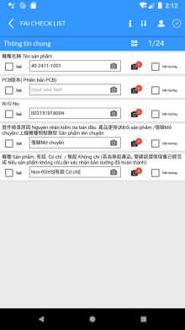
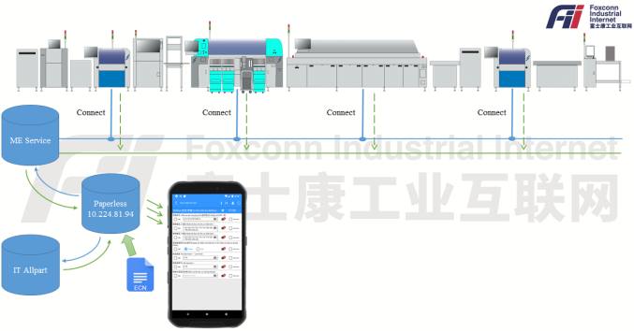
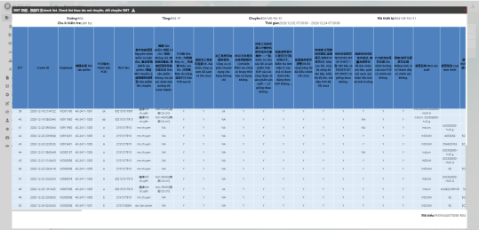
FAI Checklist System
已完成
已完成
已完成
已完成
1, FAI Form Management
(Create and update form content)
http://10.224.81.94:8888/paperless/report-form
2, QR code Management
(Create and update QRCode)
/paperless/qrcode-management
3, Spec & Checklist content validation
(Setup validation for form content by model and line)
http://10.224.81.94:8888/paperless/fai-config
4, FAI checklist dashboard
(Check status and information for line)
http://10.224.81.94:8888/paperless /b04-fai-2
12/29
已完成
01/08
01/15
進行中
進行中
5, Mobile APP Checklist creation and submit UI&UX
(Update notify for step when content not in spec by step)
6, Machine Parameter data collection
(Connect to Reflow, Printer,… and read program information of machine)
7, Checklist report management
(History checking and analysis data)
http://10.224.81.94:8888/paperless/machine-history

Slide 6
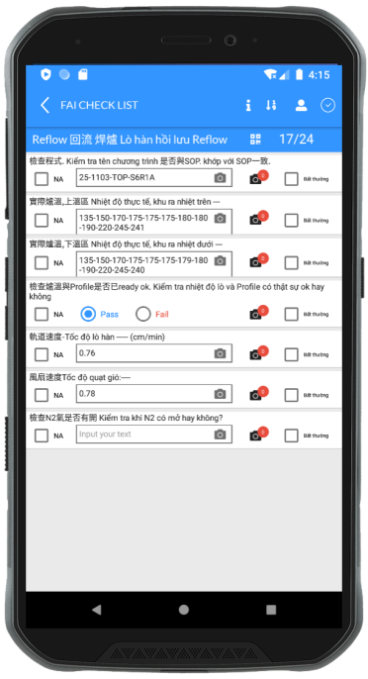
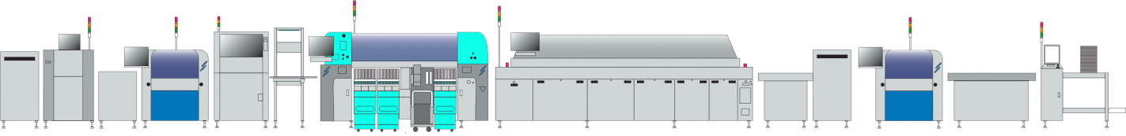
FAI Checklist
(Automation fill data model information/machine information)
Reflow Information:
- Program name/version
- Temperature of 24 zone
- Conveyor information
- Blowerfan information
→ FII Program
SMT Line
(Reflow)
ETC
(192.168.35.xxx)
ME Server
FII Server
HELLER
(192.168.35.xxx)
3, Server (Image)
(Request get machine information)
Connect
(TCP/IP)
2, App
(Request get information model/machine)
XPM
(192.168.35.xxx)
4, Server (Characters)
(Request get model information)
IT Server
SONIC
(192.168.35.xxx)
Program Image Process:
- Encodes data into images
- Image data storage
- Convert from images to data report
→ FII Program
1, Checker
(Checking FAI checklist for Line)
Model Information:
- Model name
- W/O no
- Reason (首件檢查原因)
- Type (機種): ROSH/NON-ROSH
- ECN: ECN number
→ Webservice IT Allpart
Program screenshot:
- Screenshot then checker checking FAI checklist
→ FII Program

Slide 7
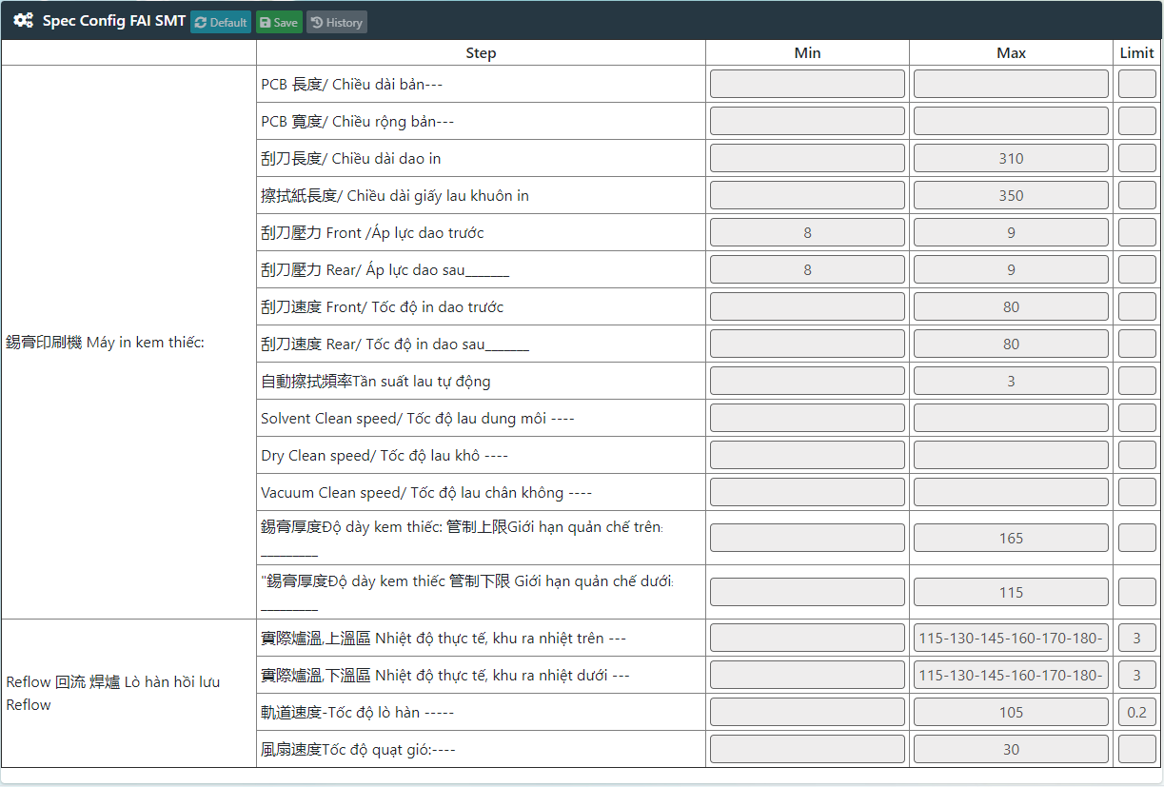
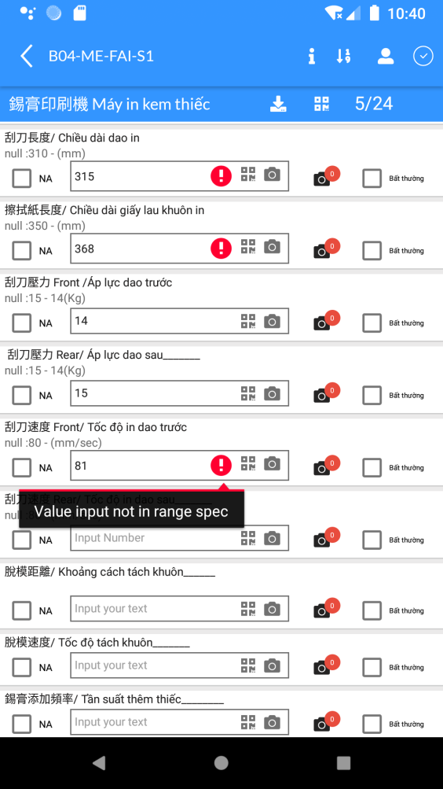
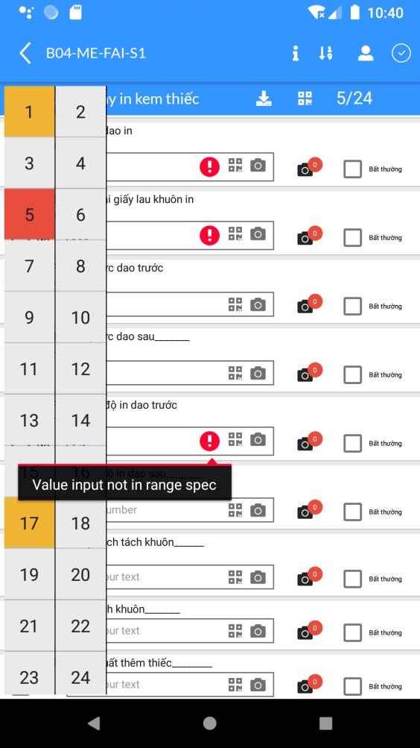
FAI Checklist
(Validation content in FAI checklist)
Admin System
They will setup parameter for content on FAI checklist by Model and Line
Checker
After Admin setup parameter for model, App will base on parameter so checking with value fill of checker, if content have issue then app will hightlight item for checker and they need re-check it.
15 – 14 (Kg)
UTL: 15 LTL: 14 Unit: Kg
App hightlight item have issue

Slide 8
Machine Collection
(Mounter)
Printer
Parameter
+
Program name
FII Server
ME Server
Mounter
Program name
Reflow
Parameter
+
Program name

Slide 9
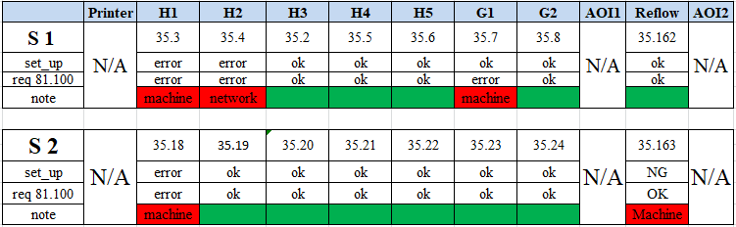
Machine Collection
(In Line)
Printer
Mounter
AOI
Reflow
Machine | Item | Status
Reflow | Program Machine | Done
 | Program Server ME | Done
 | Program Server FII | Done
Mounter | Program Machine | Done
 | Program Server ME | Done
 | Program Server FII | Done
AOI | Program Machine/Server ME/Server FII | Done
Printer | Program Machine/Server ME/Server FII | Done

Slide 10
ECN
(Notify for user)
IQC
PM
MPM
ME
PC
IPQC
…
Scan PNs in Allpart
Send notify for Applicant by CFT
IT
Allpart
FII Server
Update status PN on ECN evaluation
Check status PNs change on ECN evaluation

Slide 11
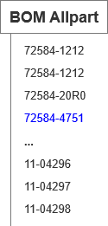
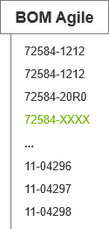
BOM Compare
(BOM data)
Agile
IT
Allpart
BOM current using on Line
Download BOM data
(Account)
Data PNs
FII Server
Compare
FAI
Notify for checker
(Peachat/Web)

Slide 12
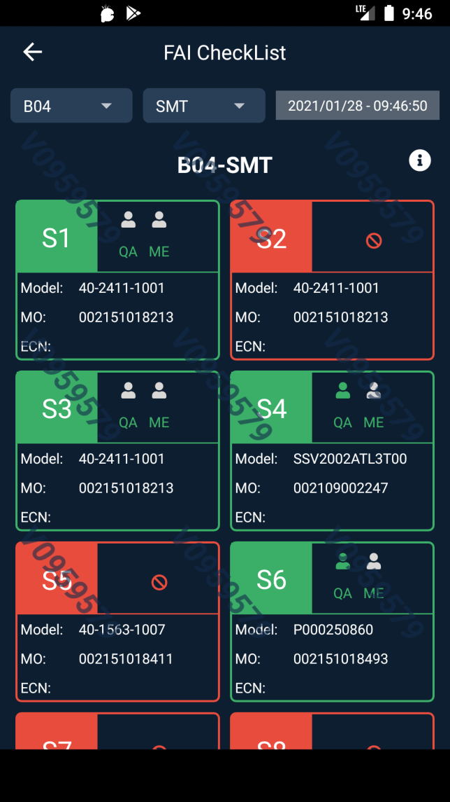
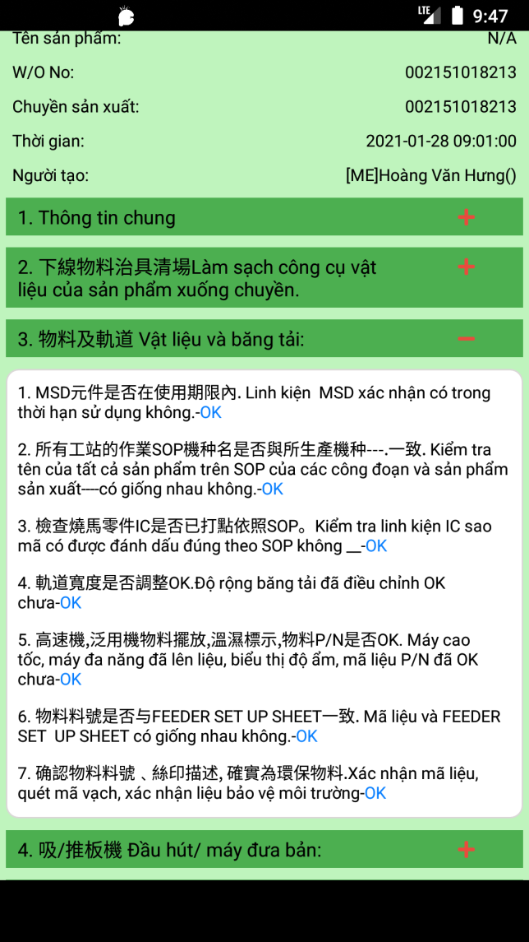
Smart Factory APP
(SMT FAI status)
Checking status
Detail FAI report

Slide 13
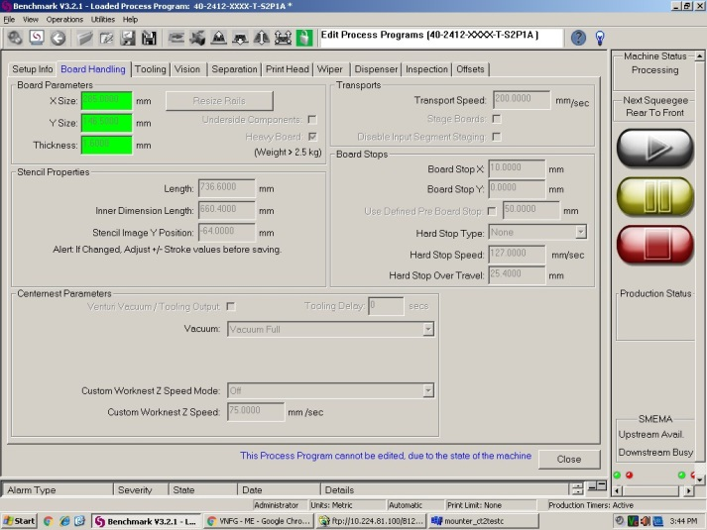
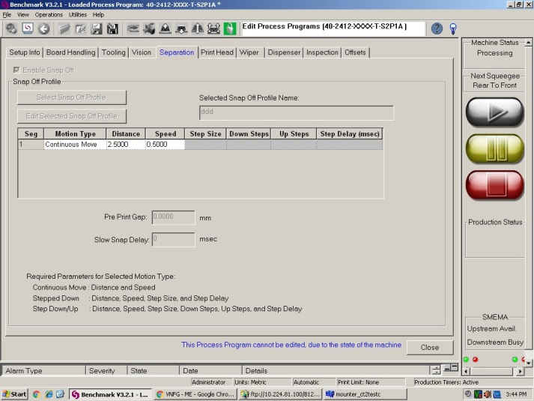
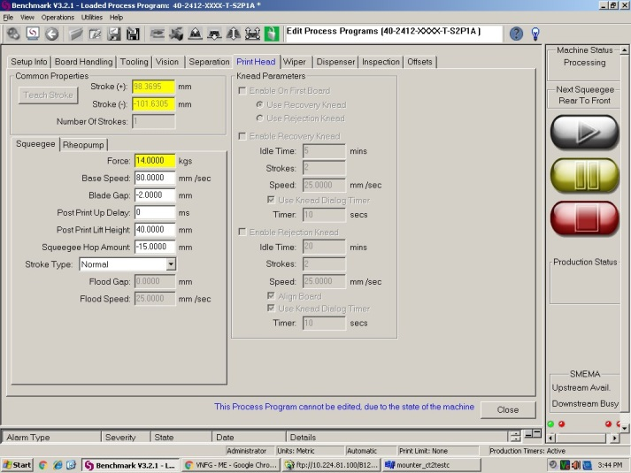
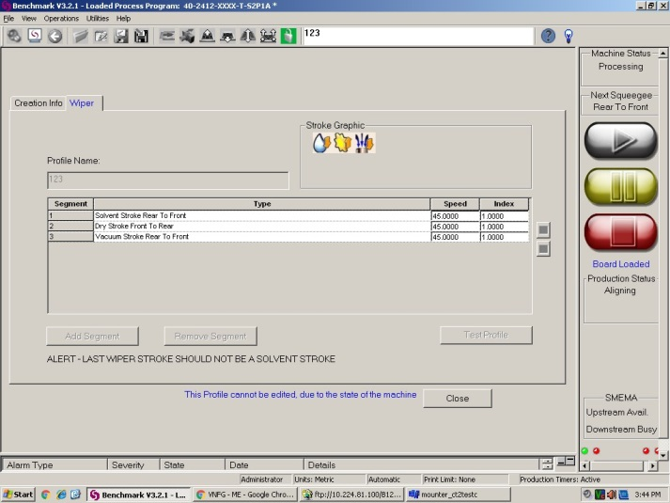
Collection data Machine
(Screenshot Printer)

Slide 14
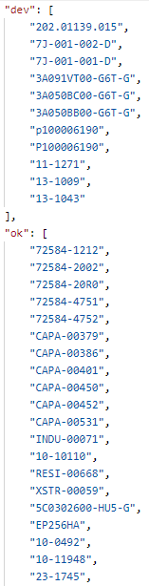
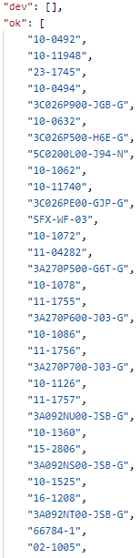
Compare BOM data
(40-2411-1001)
WO: 002151013573
WO: 002151018482
BOM Agile
Document
PN
SMT
PTH
SI

Slide 15
Compare BOM data
(40-2411-1001)
Compare BOM by PN
Compare PN in BOM Agile with BOM SAP
PASS
PASS
FAIL
PNs special
(PN haven’t in BOM)
Have PN
Have PN
Find PN in the corresponding ECN
Find PN in the DCC
Haven’t PN
Haven’t PN

Slide 16
Compare BOM data
(40-2411-1001)
Signer
(ME/QA)
1, Scan QRCode
Checker
(PD)
2, Send notify
3, Confirm
FAI
Sign
ME
1’, Send mail warning
IPQC
2’ ,Owner confirm PN
Approve
Reject
Notes:
5035 - 30509

Slide 17
Compare BOM
PM
Deviation
ME
FAI
- Config PN by Station
- Add deviation for station
Allpart
Kitting
PD
Paperless
(compare BOM)
-> Notify to IPQC & ME
Paperless
(compare BOM)
-> Notify to IPQC & ME
Signer
(ME/QA)
Webview
1, Scan QRCode
Checker
(PD)
FAIL
3, Confirm
FAIL
2, Send notify
IPQC
Sign
FAIL
ME
PASS
ME
1’, Send mail warning
FAI
PN
compare
PASS
PASS
IPQC
PASS
2’ ,Owner confirm PN
IPQC: Kiểm tra và đánh giá tính khả dụng của liệu nếu liệu đáp ứng đủ điều kiện để sản xuất yêu cầu ME chạy đơn sử dụng đặc biệt
(*) ME add deviation for WO
Approve
Reject

Slide 18
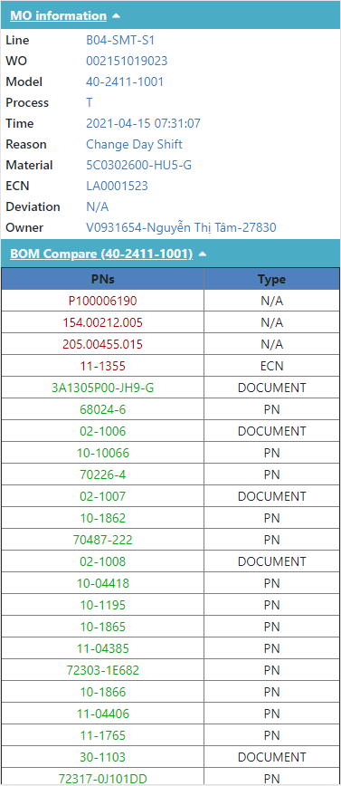
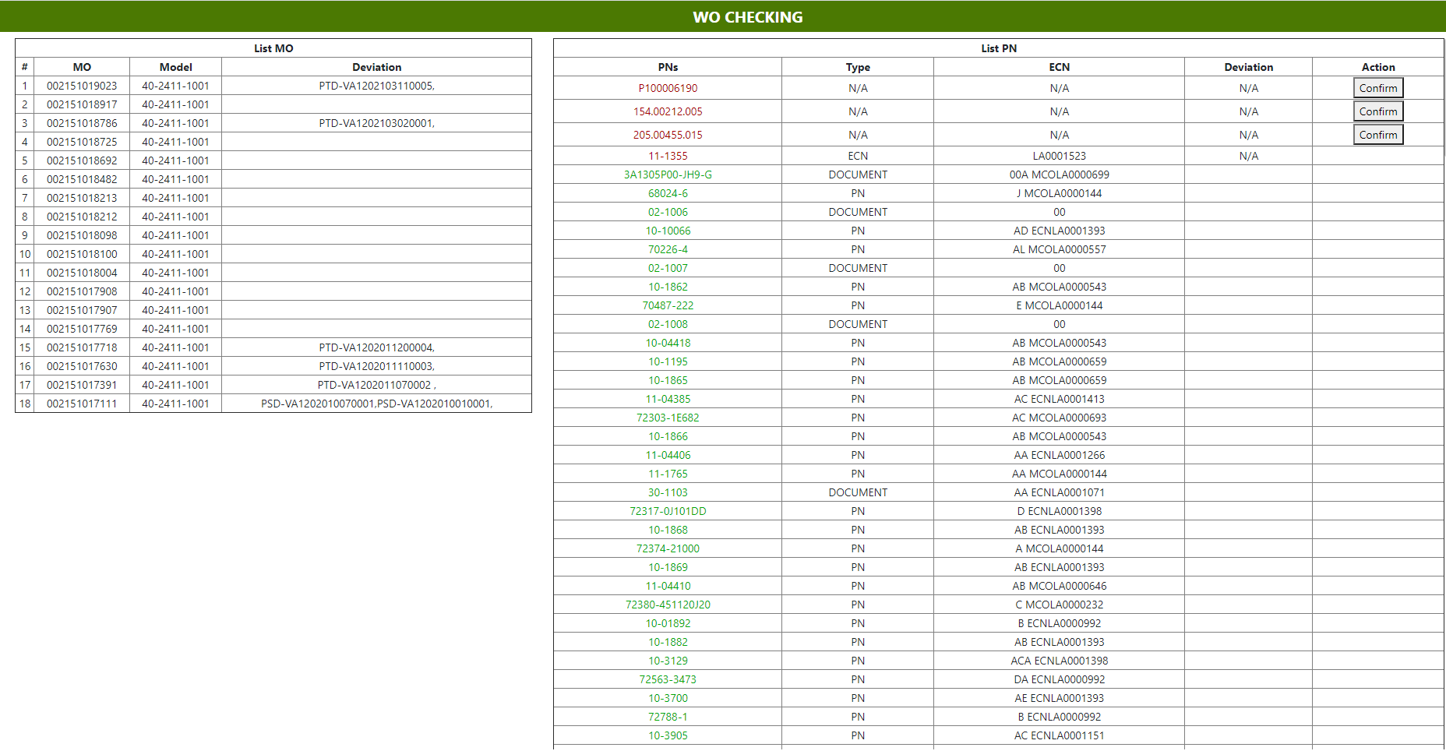
FAI – SMT
Form FAI
- The system can’t collection data WO waibao -> Data fill wrong (F12)
- The line S1 don’t sort value temp
- Add item capture checking in form
- Add show detail Deviation & ECN
WO Detail
Compare BOM by WO

Slide 19
FAI – PTH
Form FAI
- Add item check parameter for machine (temp, flux,…)
- Add item capture checking in form
- Re-format form FAI PTH + Update view check FAI PTH in system
Confirm Form FAI PTH
Add new form FAI PTH to system
Test new form
Collection data WO detail to report
04/17
04/20
04/20

Slide 20
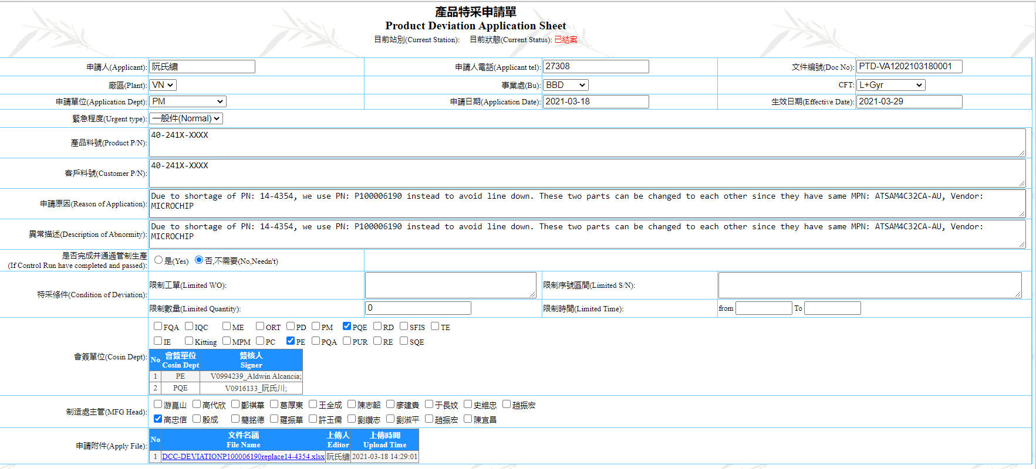
DCC Control System
- Update format date input for field Limited Time
- Change format field Product P/N when up to system: Model 1, Model 2,…, Model n
- Field Limited WO, Limited Time, Limited Quantity require fill

Slide 21
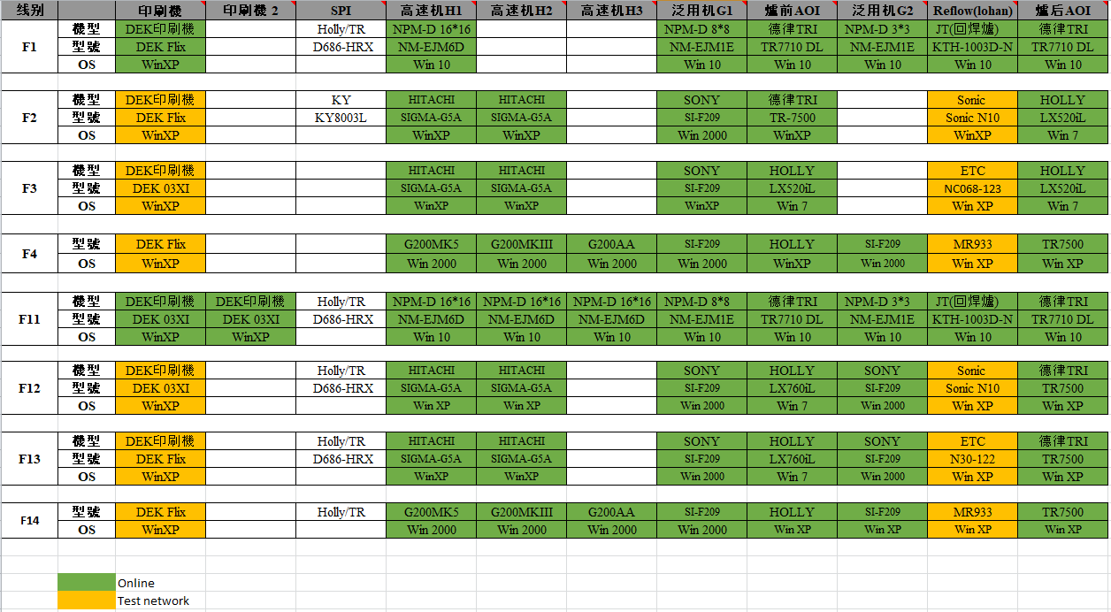
SMT Collection data
Demo get data
高速机/泛用机 Mounter: Get data (Pick up rate, Input, Output, Fail, PN by slot, Circle Time)
爐前/爐后 AOI: Get data (Error code, Location code, Yeild rate, WIP, Output, D.Qty)

Slide 22
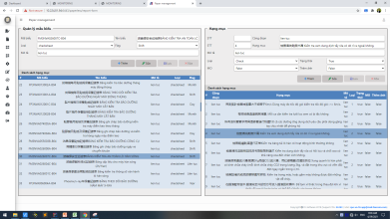
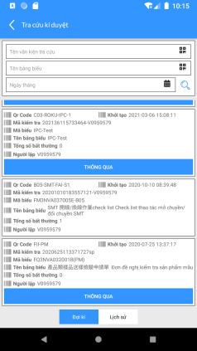
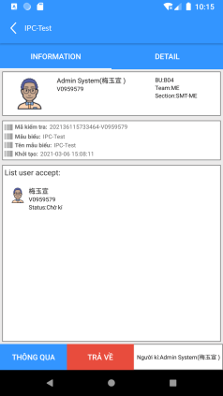
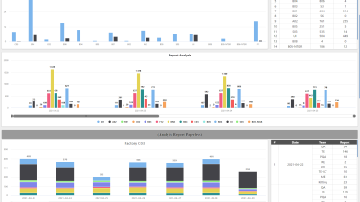
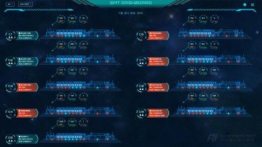
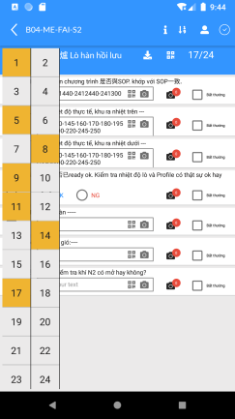
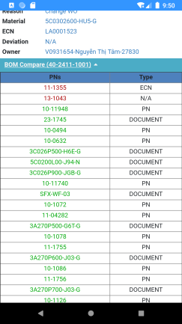
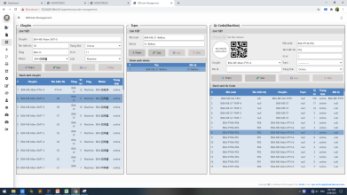
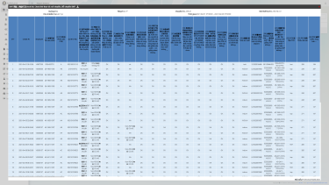
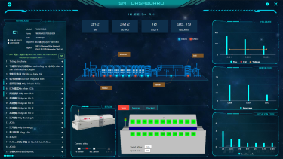
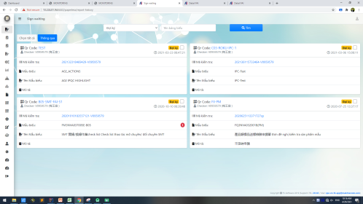
FAI Usecase
Admin
Checker
Signer
Manager
FAI
Setup Form
Create Report
Sign management
Statistic & Analysis data
- Create form paper
- Create QRCode scan
- Create report
- Data collection
- BOM compare
- Review & check
- Sign report
- Checking status
- Analysis data parameter
Setup Paper
Analysis
& Statistic
Setup QRCode
Create report
BOM Compare
Sign

Slide 23
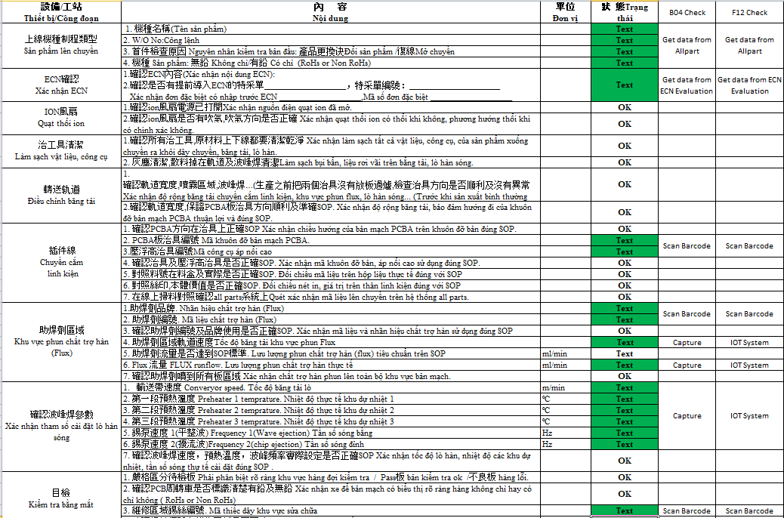
Form FAI PTH
(Update content form)
Issue | Status
Test new form FAI PTH checklist on B04 – PTH 2 | Done
Verify new format form PTH FAI checklist for F12 | Done
Cut in new format form PTH FAI for line PTH 2 in F12 | Ongoing
B04 Feedback:
- Thiếu kỹ sư ME để check
- Thông tin tham số được hiển thị trên máy, PD có thể check

Slide 24
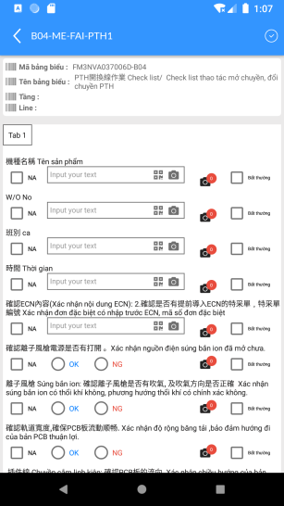
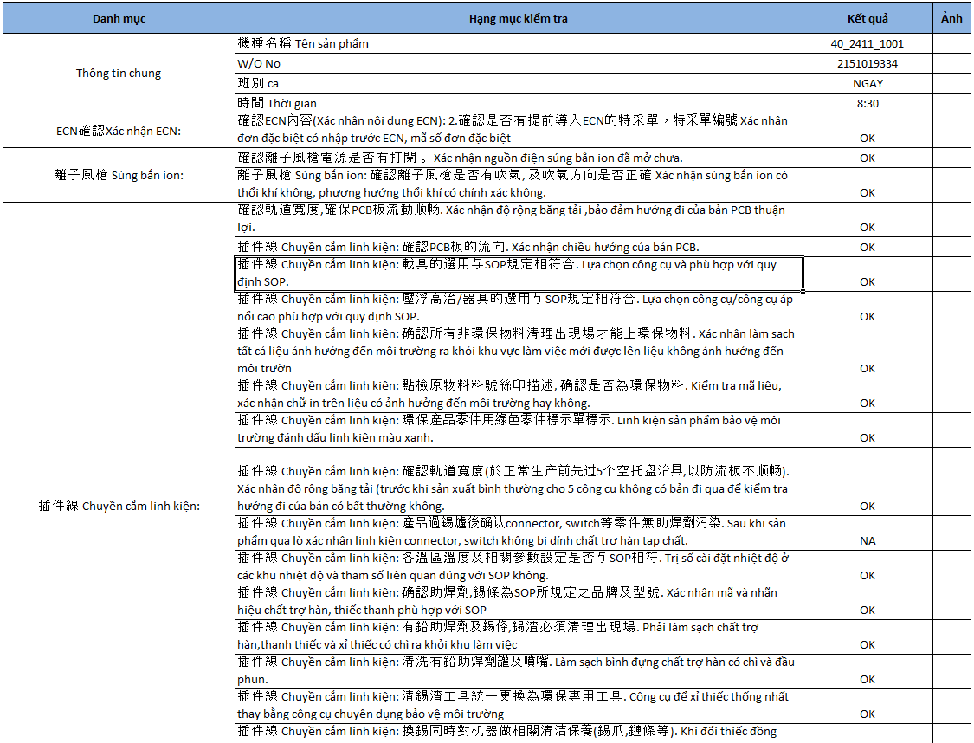
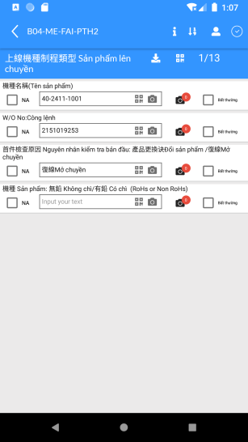
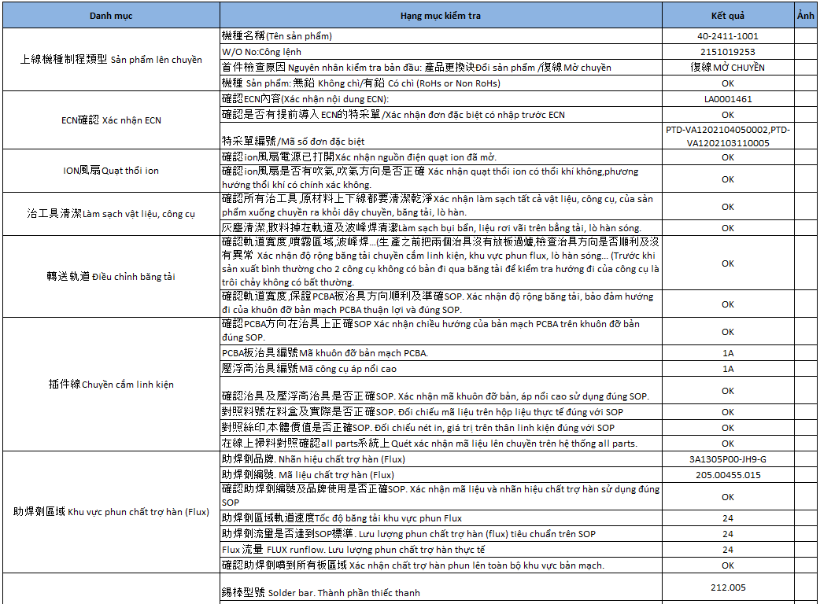
FAI Checklist (PTH/SMT)
(Processing checklist)
ITEM
Current
Update
PD
(Check)
Due Date: 05/14
1, Process
(Ongoing)
PD
(Check)
ME
(Confirm)
QA
(Confirm)
QA
(Confirm)
ME
(Check)
2, Form Check
(Cut in PTH2)

Slide 25




FAI Checklist
(Check permission in report)
Have permission fill data
(Operator)
Haven’t permission fill data
(Normal User)
(?) Who is setup process sign
https://10.224.81.94:6443/paperless/sample-report-pm?id=1051

Slide 26
Upgrade permission in system (Due date: 05/28)
(Permission user in system)
Current
Update
Manger BU
Admin
Team Leader
Team Leader
…
Team Leader
Leader/
Confirmer
Leader/
Confirmer
…
Leader/
Confirmer
Operator
Operator
…
Operator/
Checker
…
Operator/
Checker
Checker
Confirmer
Checker
Confirmer
- Manager BU:
+, Information management in BU/CFT
+, Permission management for user in BU/CFT
+, Department management in BU/CFT
- Team Leader:
+, Member management (Update information for member in Dept)
+, Line management
- Operator: Create and confirm and check history report
- Admin:
+, Update permission sign/check for normal user
+, Setup QRCode and Form Paper in System
- Confirmer: Review and confirm content in report
- Checker: Create checklist

Slide 27

FAI Abnormal Management
Type data:
- Text: User select item Abnormal when value wrong
- OK/NG: -> remove item Abnormal
Update:
- Add remark for item when the item have abnormal
- Valuation for improve content of Owner (Model, WO, Material,…)
Current
Choose Confirmer
Check
Notify
Improve issue
Confirmer
(?) Process improve abnormal in FAI

Slide 28
Stage
SMT
(FM3NVA037005E)
PTH
(FM3NVA037006F)
SI
(FM3NVA037015C)
錫膏印刷機 Máy in kem thiếc
插件線Chuyền cắm linh kiện
物料及傳送帶 Vật liệu và băng tải
高速機Máy cao tốc
助焊劑區域 Khu vực phun chất trợ hàn
離子風槍 Súng Ion
泛用機 Máy đa năng
確認波峰焊參數 Xác nhận tham số cài đặt lò hàn sóng
測試 Test
AOI
組立 Lắp ráp
Reflow 回流 焊爐 Lò hàn hồi lưu Reflow
包裝 Đóng gói
Infor
Machine
ECN/Dev
Material
WO
Shift
Product
Weibao
NPI
(ME-PD-QA-PM-TE)
MP
(ME-QA)
Control Run
(ME-QA)
Deviation
(ME-QA)
Comfirm Process

